Slide 1


Decision Making In Event Management Using Data Science

Slide 2
Decision Making In Event Management Using Data Science

Slide 3
INTRODUCTION
This project analyses the past data related to event organizing and helps make informed decisions.
when planning an optimal event, whose requirements could be to:

Slide 4

Promote a cause
Raise maximum funds for a cause
Market a product
Stimulate an emotion
Help a business grow, etc.

Slide 5
EXISTING SYSTEM
The existing system fails to provide accurate calculations for event planning, leading to problems like:
Having more guests or attendees than you planned for is an event mistake.
Overspending
Understaffing
Leaving little to no time for event set up or take down is an event mistake.
Not having a backup plan for bad weather is an event problem.
Forgetting to create an attendee engagement plan for before, during, and after the event is a challenge.

Slide 6
Proposed System
The objectives of the proposed system are:
Analyze successful fundraising events and event planning and marketing strategies
Tackle afore mentioned problems using predictions and estimations
Estimate the success of a particular event based on the interests of the target audience
Draw meaningful information to improve decision-making when it comes to organizing an event

Slide 7
Data process phases
EDA analysis
Outlier handling
MODEL FITTING
KNN
DECISION TREE
MLP
Model validation
DATA PRODUCT

Slide 8
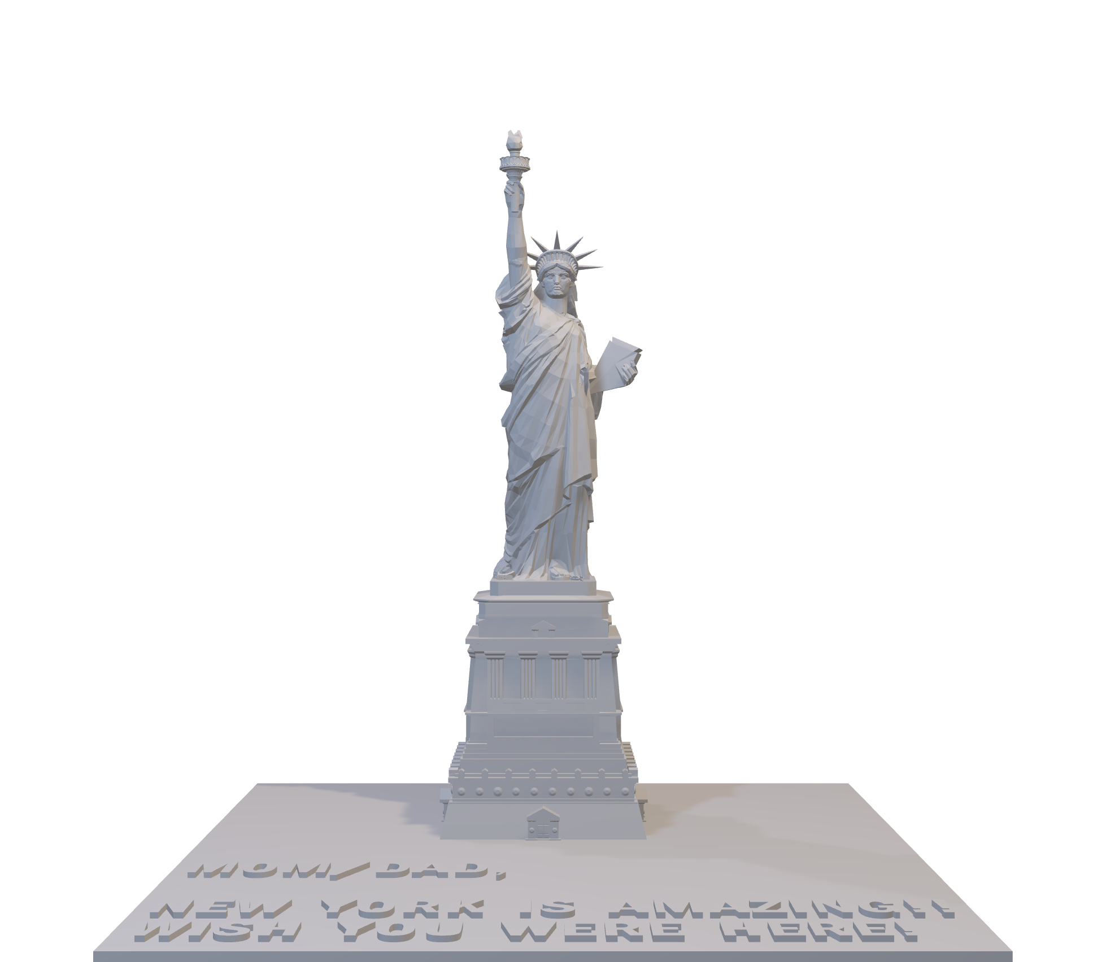
SYSTEM REQUIREMENTS
Software Requirements
An Intel-compatible platform running Windows 11, 10 /8.1/8 /7 /Vista /XP /2000 Windows Server 2022, 2019 /2016 /2012 /2008 /2003.
Hardware Requirements
At least 256 MB of RAM, a mouse, and enough disk space for recovered files, image files, etc.

Slide 9
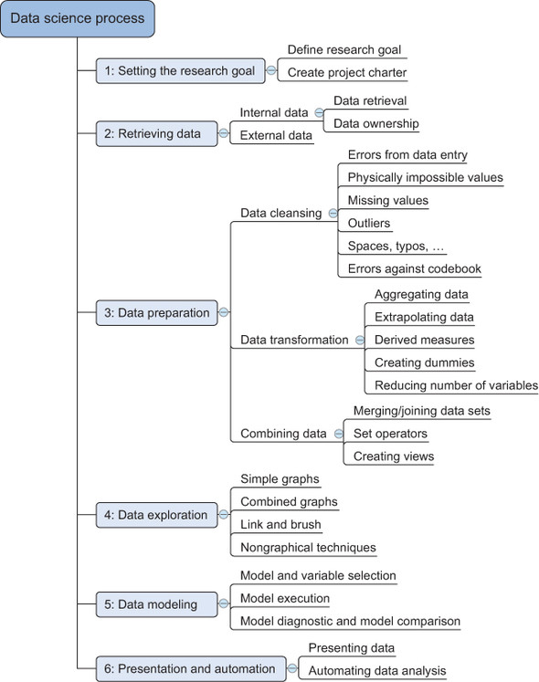
DATA SCIENCE PROCESS

Slide 10
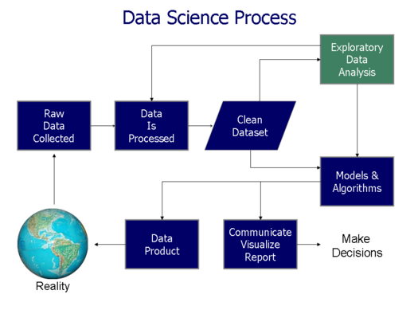


Slide 11
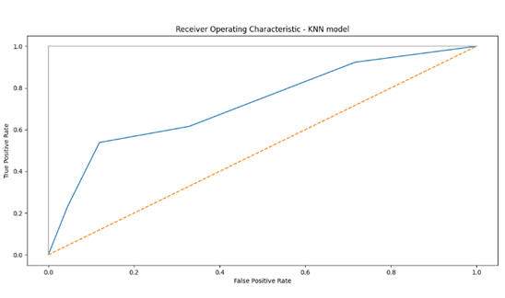
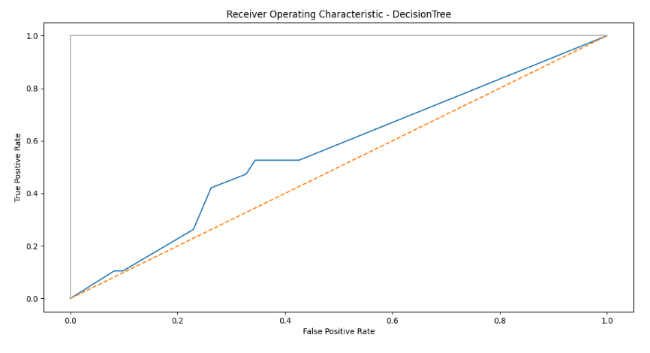
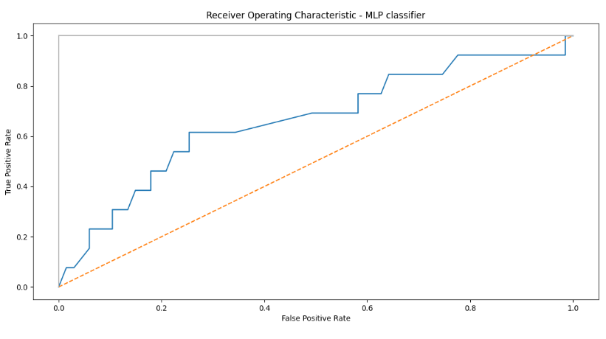

OUTPUT SCREENS
MODEL VALIDATION
KNN model
[0 1 0 1 1 0 0 0 0 0 0 1 0 0 0 0 0 0 0 0 0 0 0 0 0 0 0 0 0 0 1 0 0 0 0 0 0 0 0 0 0 0 0 0 0 0 0 0 0 0 0 0 0 0 0 0 0 0 0 0 0 0 0 0 0 0 0 0 0 0 0 0 0 0 1 0 0 0 0 0]
accuracy: 0.8375
roc_auc_score for KNN model: 0.7256027554535017
DECISION TREE CLASSIFIER
[0 0 0 0 0 0 0 0 0 0 0 0 0 0 0 0 0 0 0 0 0 0 0 0 0 0 0 0 0 0 0 0 0 0 0 0 0 0 0 0 0 1 0 0 0 0 0 1 0 0 0 0 0 0 0 0 0 0 0 0 0 0 0 0 0 0 0 0 0 0 0 0 0 0 0 0 0 0 0 1]
accuracy: 0.75
roc_auc_score for DecisionTree: 0.5953408110440034
MLP CLASSIFIER
[0 0 0 0 0 0 0 0 0 0 0 0 0 0 0 0 0 0 0 0 0 0 0 0 0 0 0 0 0 0 0 0 0 0 0 0 0 0 0 0 0 0 0 0 0 0 0 0 0 0 0 0 0 0 0 0 0 0 0 0 0 0 0 0 0 0 0 0 0 0 0 0 0 0 0 0 0 0 0 0]
accuracy= 0.8375
roc_auc_score for MLP classifier: 0.6624569460390356
Eda analysis

Slide 12
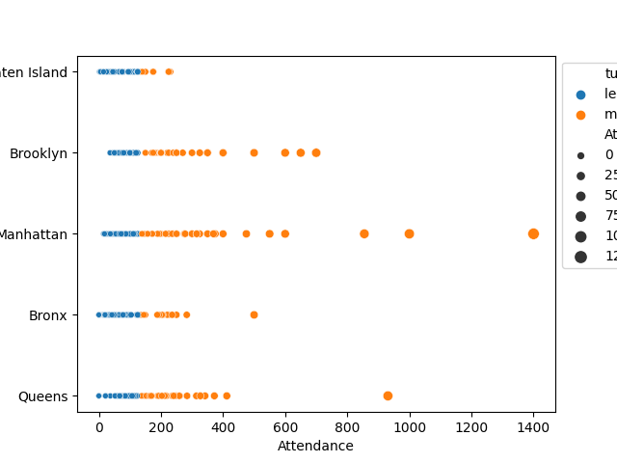
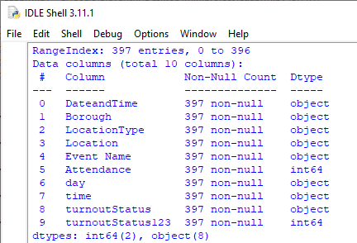
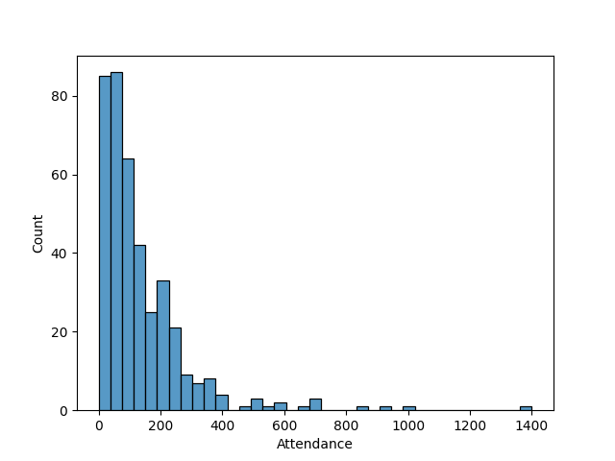
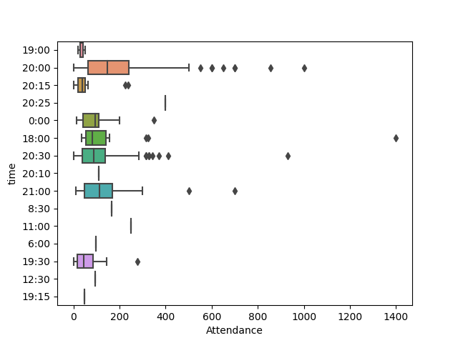
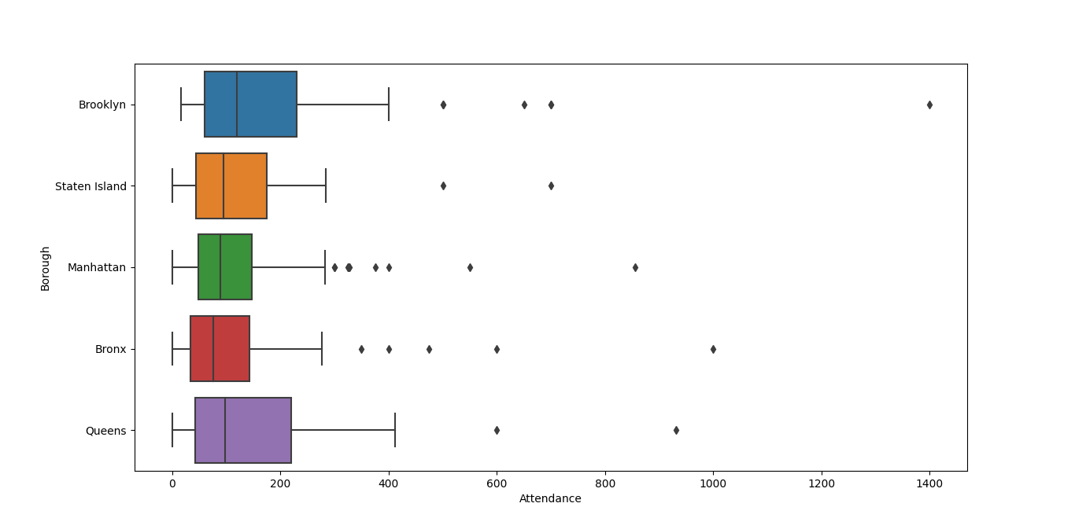
Outlier handling
OUTPUT SCREENS
Eda analysis

Slide 13
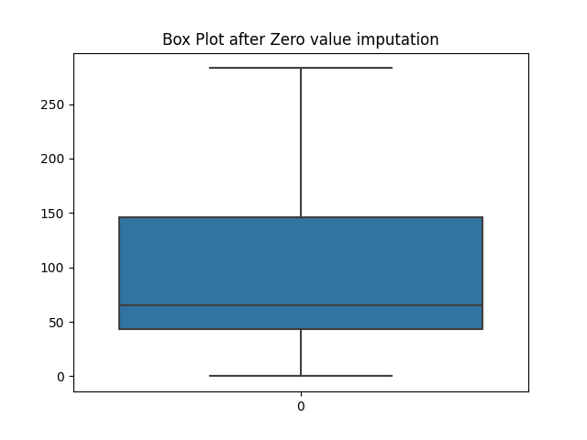
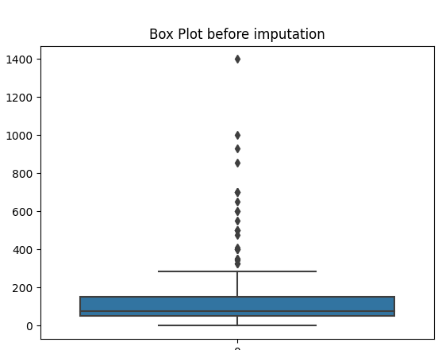
Outlier handling
KNN D T MLP

Slide 14
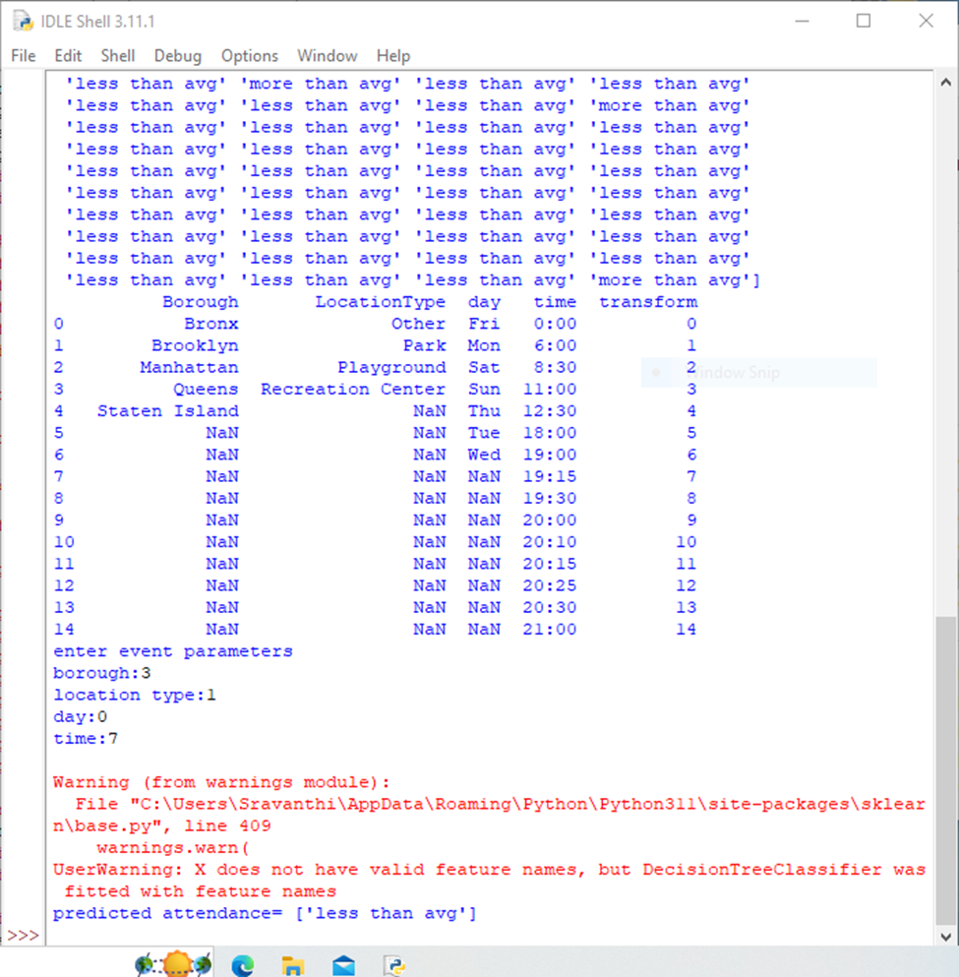
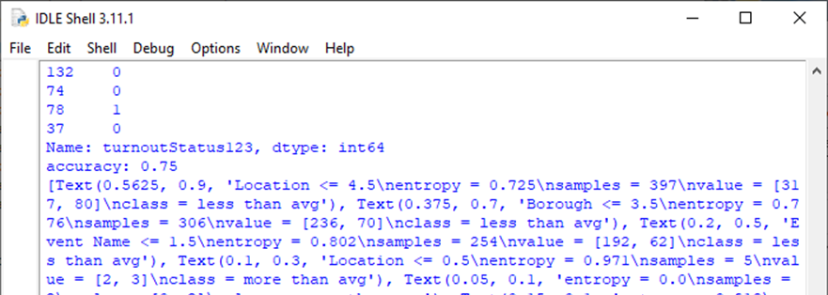
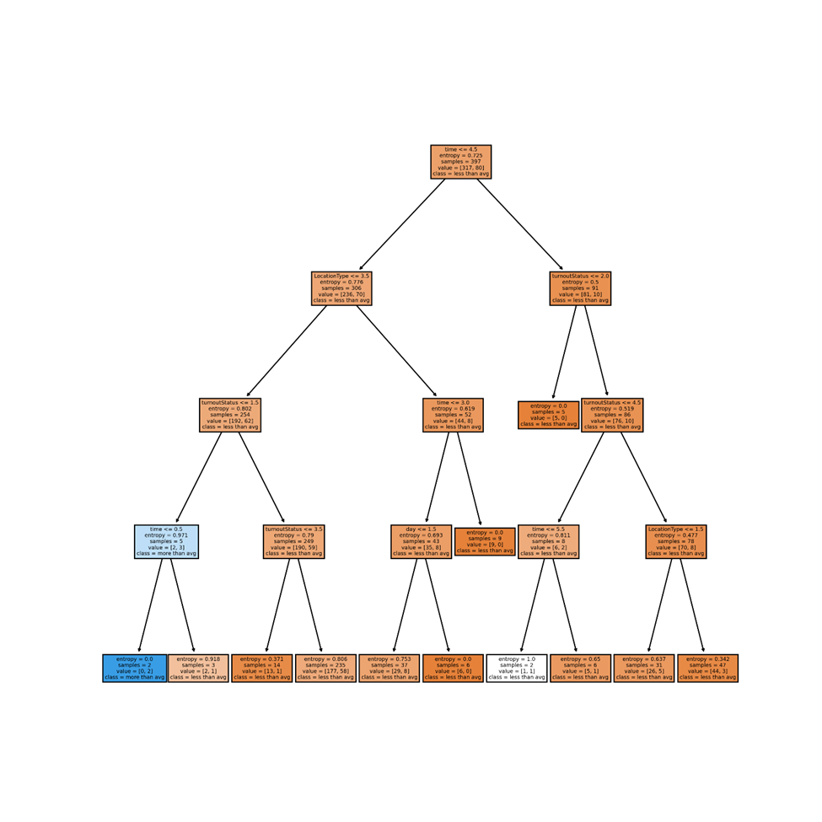
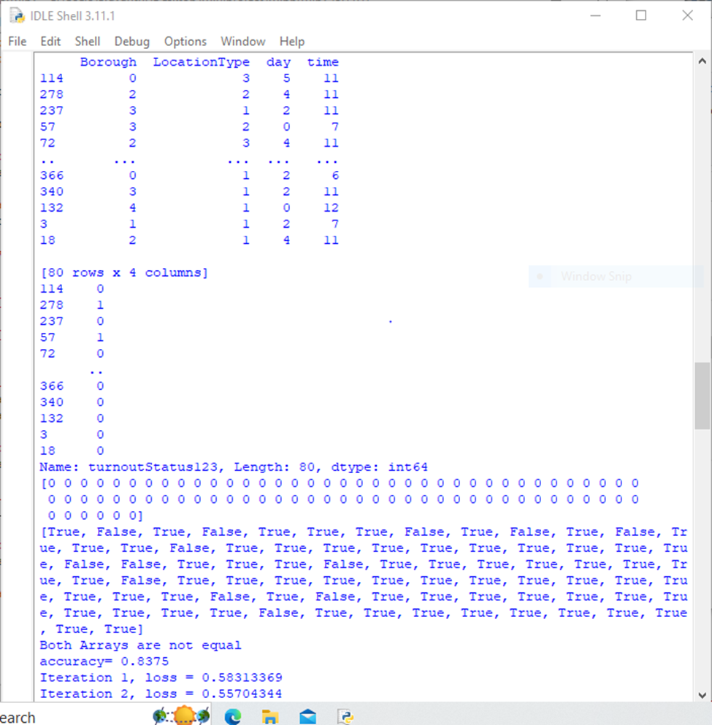

KNN DT MLP
KNN
DT
MLP

Slide 15
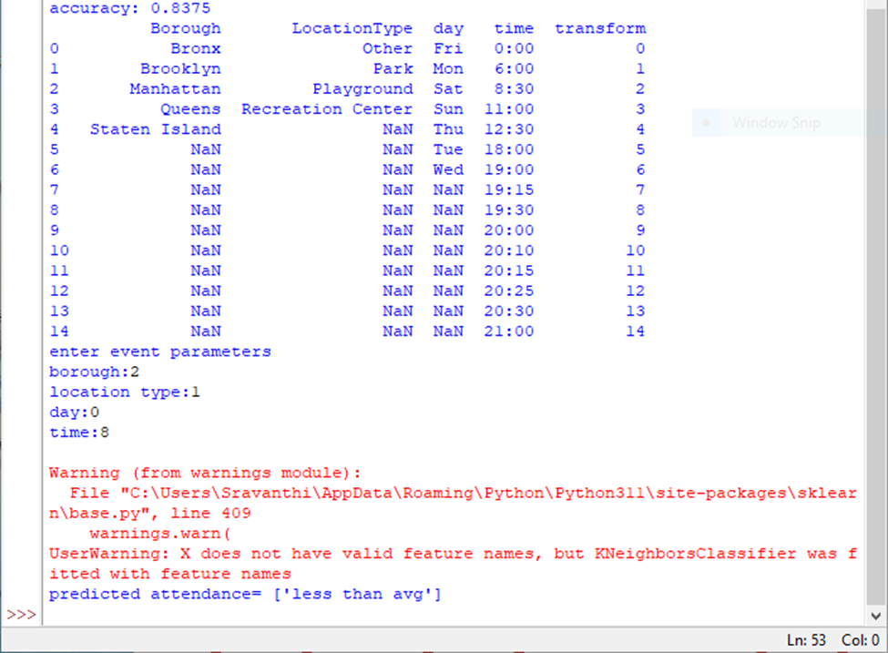

Data product

Slide 16


